Slide 1
Linear-Time Sorting Algorithms:
Counting Sort, Radix Sort & Bucket Sort

Slide 2
How Fast Can We Sort?
First, an observation: all of the sorting algorithms so far are comparison sorts
  The only operation used to gain ordering information about a sequence is the pairwise comparison of two elements
  Theorem: all comparison sorts are Ω(n log n)
    A comparison sort must do O(n) comparisons (why?)
    What about the gap between O(n) and O(n log n)

Slide 3
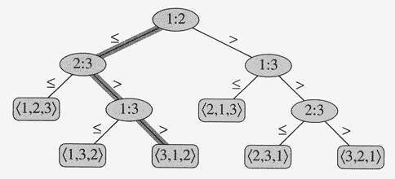
Decision Trees
Decision trees provide an abstraction of comparison sorts
  A decision tree represents the comparisons made by a comparison sort.

Slide 4
Decision Trees
Theorem 8.1: Any comparison sort algorithm requires Ω(n log n) comparisons in the
worst case.
Proof: The decision tree must have n! leaves, one corresponding to each possible
output. Moreover, the branching-factor of the tree is two, because each comparison gives one of two results.
The height of the decision tree is the number of comparisons made in the worst case.
Therefore, the minimum possible height of a binary tree with n! leaves is the number of comparisons in the worst case.
Min. possible height = log (n!) = Θ(n logn) (using Stirling’s approximation).

Slide 5
Sorting In Linear Time
Counting sort
  No comparisons between elements!
  But…depends on assumption about the numbers being sorted
    We assume numbers are in the range 1, …, k
  The algorithm:
    Input: A[1..n], where A[j] ∈ {1, 2, 3, …, k}
    Output: B[1..n], sorted (notice: not sorting in place)
    Also: Array C[1..k] for auxiliary storage

Slide 6
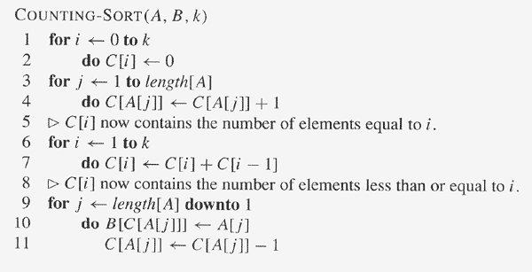
Counting Sort
COUNTING-SORT assumes that each of the input elements is an integer
in the range 0 to k, inclusive.
A [1..n] is the input array, B [1..n] is the output array, C [0..k] is a
temporary working array.

Slide 7
Counting Sort
Takes time O(k)
Takes time O(n)
What will be the running time?
Total time: O(n + k)
  Usually, k = O(n)
  Thus counting sort runs in O(n) time

Slide 8
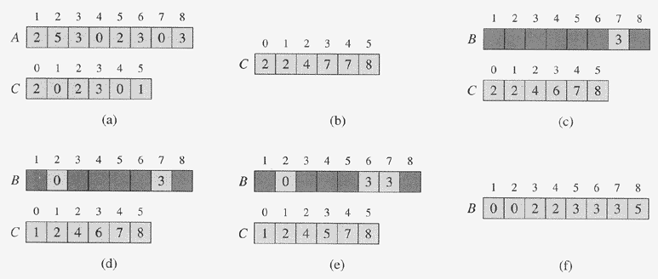
Counting Sort

Slide 9
Counting Sort
Cool! Why don’t we always use counting sort?
Because it depends on range k of elements
Could we use counting sort to sort 32 bit integers? Why or why not?
Answer: no, k too large (2³² = 4,294,967,296)

Slide 10
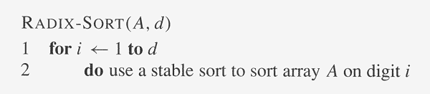
Radix Sort
Radix sort:
  Assumption: input has d digits ranging from 0 to k
  Basic idea:
    Sort elements by digit starting with least significant
    Use a stable sort (like counting sort) for each stage
A stable sort is one where items with the same value appear in the
same order in the output as they appeared in the input.
Is Counting-Sort stable?!!

Slide 11
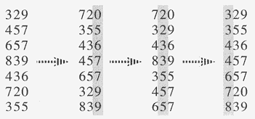
Radix Sort

Slide 12
Radix Sort
Lemma 8.3: Given n d-digit numbers in which each digit can take up to k possible values. Radix-Sort correctly sorts these numbers in Θ(d (n +k)) time.
Proof: Perform Counting-Sort on each column.
Running time = Θ(n +k) * No. of columns
= Θ(d (n +k)) ♦
When d is constant and k = O(n),
Running time = O(n)

